Slide 1
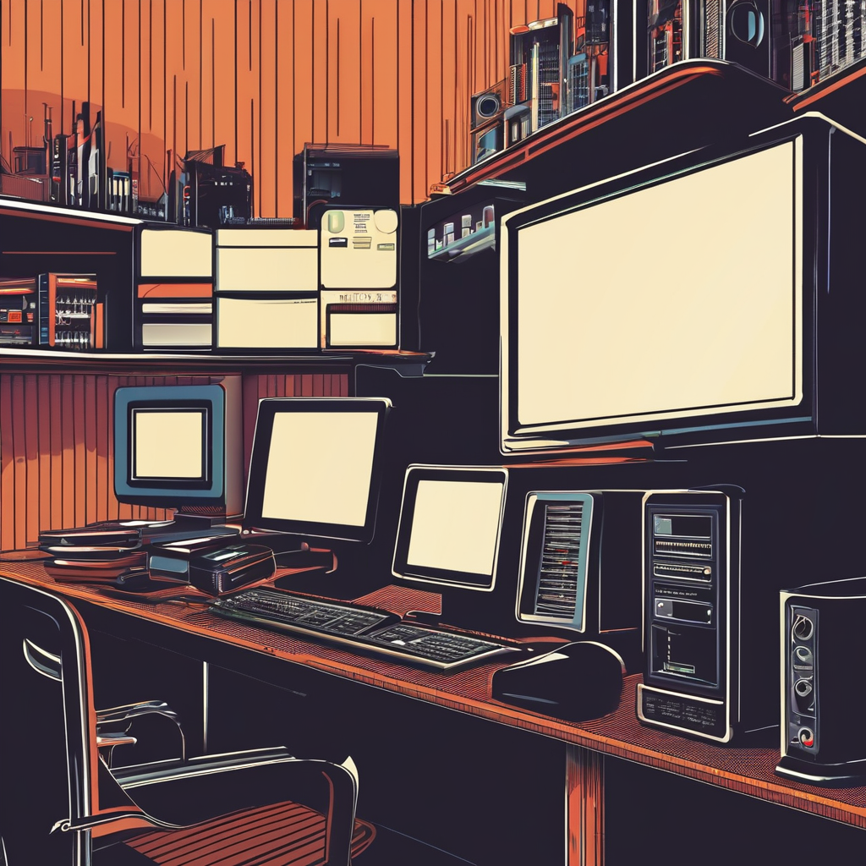
Case Study
Of
Boot Process
By Udbhav Chandravanshi, Tushar sahu , sabib sidar.
Guided by Miss. Anjali Goswami

Slide 2
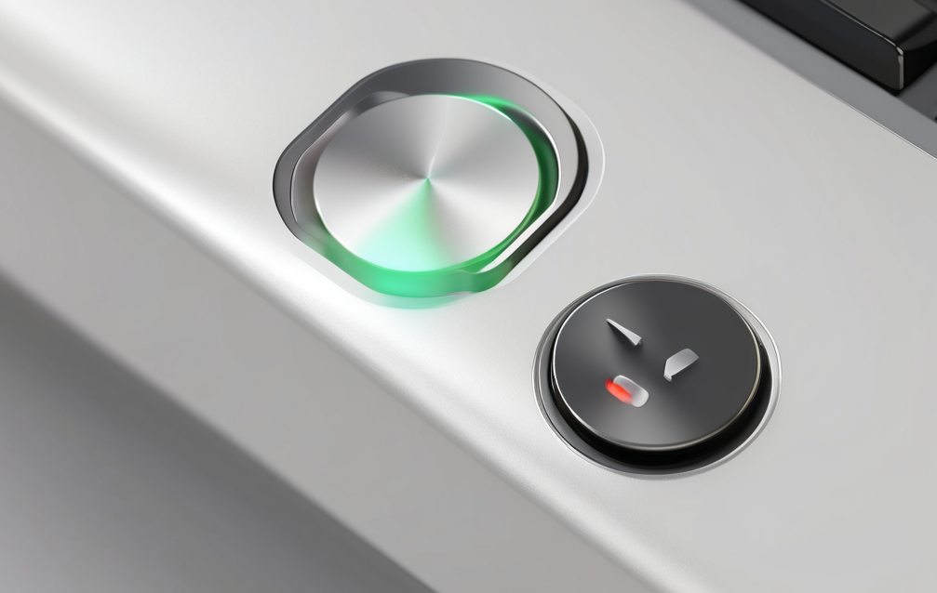
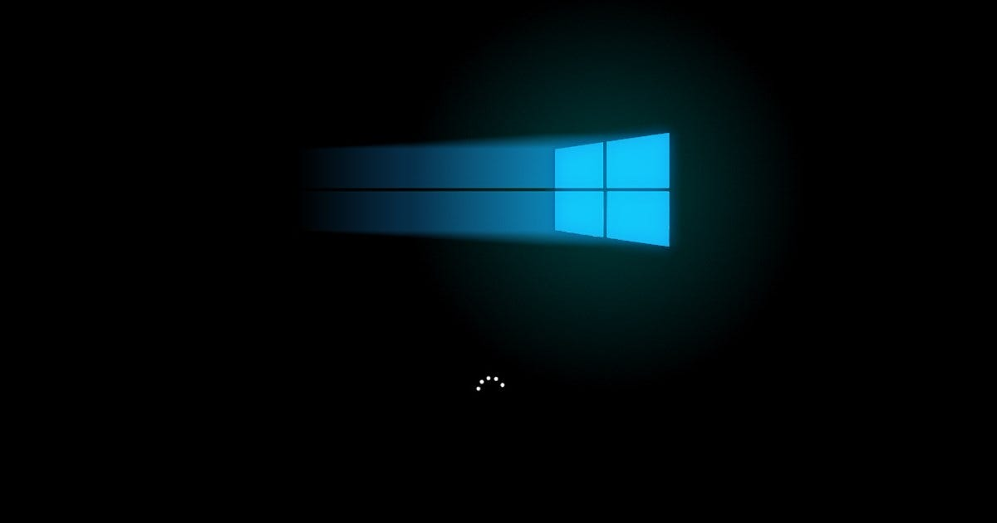

What is Boot Process ?
The boot process is the sequence of operations that a computer system performs to load the operating system into memory and prepare it for execution.
When you power on your computer, it initiates the boot process.
Pressing this button sends a signal to the power supply unit, which provides the necessary electrical power to the various components of the computer and ends when the operating system is fully loaded and ready for user interaction.

Slide 3


Power-On Self-Test (POST):
Initial hardware diagnostic test.
Checks CPU, RAM, storage, and peripherals.
Displays error messages if issues are found.
Operating System Kernel Initialization:
Takes control after the boot loader.
Initializes essential system components like memory management and device drivers.
Sets up environment for running applications.
Overview
of
Boot
Process
Stages:
BIOS/UEFI Initialization:
Initializes hardware components.
Loads the boot loader.
Provides firmware interface for configuring settings.
User Space Initialization:
Starts user space processes.
Loads system services, daemons, and user applications.
Initializes graphical user interface (GUI) components for user interaction.
Boot Loader Stage:
Loads the operating system kernel into memory.
Configures boot options.
Examples include GRUB for Linux and NTLDR for Windows

Slide 4
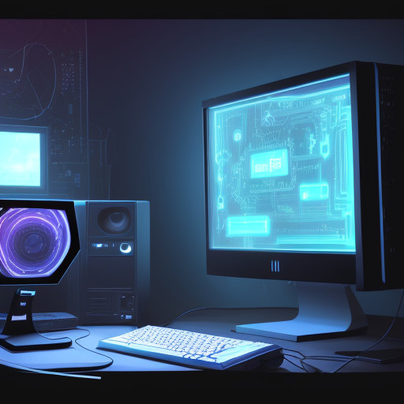
Case Study
Of
Boot Process & Solution -

Slide 5
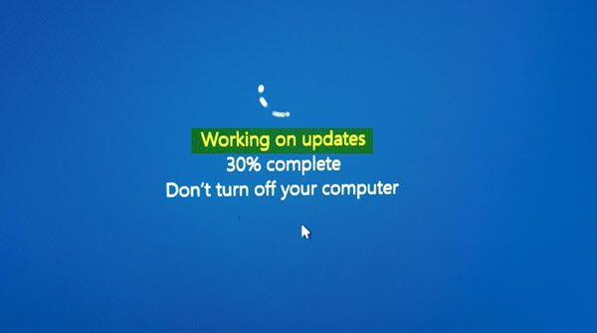
Case Study 1
Slow Boot Time:
Issue: A computer takes an unusually long time to boot up.
Solution:
Check for unnecessary startup programs and disable them.
Ensure that the hard drive is not fragmented; defragment if necessary.
Update device drivers and firmware.
If using an HDD, consider upgrading to an SSD for faster boot times.
Reasons:
Malware or Virus Infections
Hardware Issues
Background Services and Processes
Insufficient RAM:
Too Many Startup Programs
Fragmented or Outdated Hard Drive
☹
Notes:
Too Many Startup Programs
Fragmented Hard Drive
Outdated Hardware Drivers or Firmware
Insufficient RAM
Malware or Virus Infections
Background Services and Processes

Slide 6
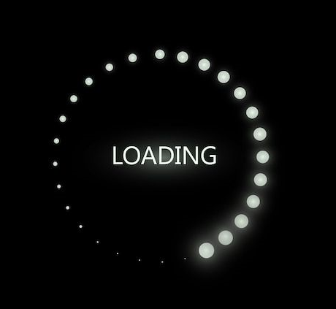
Case Study 2
Boot Loop:
Issue: The computer displays an error message indicating that the boot device cannot be found.
Solution:
Boot into Safe Mode to troubleshoot potential software conflicts
Check hardware connections and ensure all components are properly seated.
Reset BIOS/UEFI settings to default.
Repair or reinstall the operating system if necessary.
Reasons:
BIOS/UEFI Configuration-
BIOS/UEFI Update
Incorrect Boot Order: Cause the system to repeatedly attempt to boot from an invalid or non-bootable device.
Software Issues-
Operating System Errors: Corrupted system files, incompatible drivers, or software conflicts
Virus or Malware Infections: Malicious software can disrupt system operations and manipulate system operations
Notes:
Too Many Startup Programs
Fragmented Hard Drive
Outdated Hardware Drivers or Firmware
Insufficient RAM
Malware or Virus Infections
Background Services and Processes

Slide 7
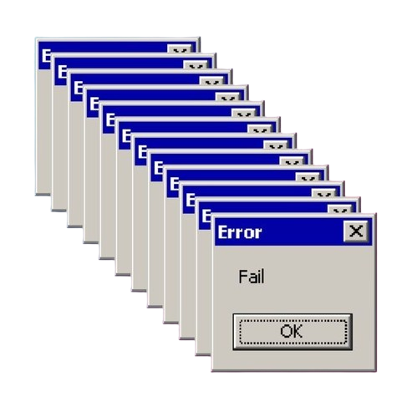
Case Study 2
Issue: The computer displays an error message indicating that the boot device cannot be found.
Reasons:
Hardware Issues:-
Overheating
Faulty Power Supply
Faulty Hardware Component
Driver or Software Updates:-
Driver Conflicts: Incompatible or outdated device drivers can lead to system crashes and restarts
Recent Software Installation: Newly installed software or updates may introduce bugs or conflicts that cause the system to restart unexpectedly.
Power Surges or Fluctuations: Power surges, electrical fluctuations, or issues with the electrical supply can cause the system to restart abruptly
Notes:
Too Many Startup Programs
Fragmented Hard Drive
Outdated Hardware Drivers or Firmware
Insufficient RAM
Malware or Virus Infections
Background Services and Processes

Slide 8

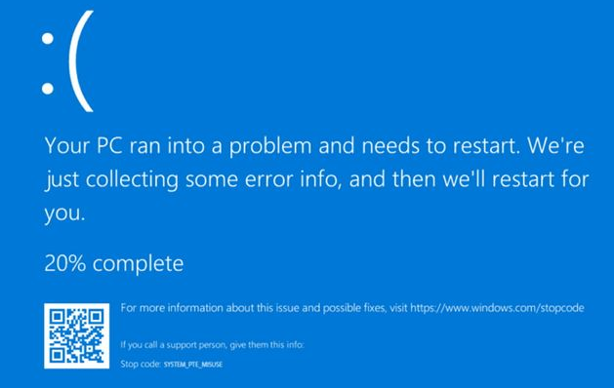
Case Study 3
Blue Screen of Death (BSOD) During Boot:
Issue: The system encounters a critical error and displays a blue screen during the boot process.
Solution:
Boot into Safe Mode and uninstall recently installed drivers or software.
Run memory diagnostics to check for RAM errors.
Check for overheating issues and ensure proper ventilation.
Update BIOS/UEFI firmware if available.
Check the configuration & compatibility of software and hardware.
Reasons:
Faulty RAM (Random Access Memory): Corrupted or defective RAM modules can cause BSOD errors during boot.
Incompatible Hardware: Certain hardware configurations may be incompatible with specific software or drivers, leading to BSOD errors during boot.
Software Compatibility Issues: Certain software applications or drivers may not be compatible with the operating system version or other installed software, resulting in BSOD errors during boot.
Corrupted System Files: System files necessary for booting may become corrupted due to improper shutdowns, software conflicts, or malware infections, leading to BSOD errors during boot.

Slide 9
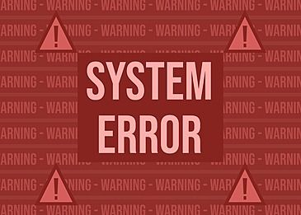
Case Study 4
Boot Error: "Operating System Not Found":
Issue: The system fails to find the operating system during boot.
Solution:
Ensure that the boot device containing the operating system is connected and recognized by the system..
Use bootable recovery media to repair or reinstall the operating system.
Check for corrupted system files using system repair tools.
Perform a disk check to identify and fix any disk errors. .
Reasons:
Faulty RAM (Random Access Memory): Corrupted or defective RAM modules can cause BSOD errors during boot.
Incompatible Hardware: Certain hardware configurations may be incompatible with specific software or drivers, leading to BSOD errors during boot.
Software Compatibility Issues: Certain software applications or drivers may not be compatible with the operating system version or other installed software, resulting in BSOD errors during boot.
Corrupted System Files: System files necessary for booting may become corrupted due to improper shutdowns, software conflicts, or malware infections, leading to BSOD errors during boot.

Slide 10
Importance Of Boot Process
System Initialization: The boot process initializes the hardware components of the computer system, ensuring that all essential components are powered on, tested, and ready for operation.
Loading Operating System: It loads the operating system kernel into memory, allowing the system to transition from a powered-off state to a fully functional state where users can interact.
Troubleshooting and Diagnostics: Helps in troubleshooting and diagnosing system issues identifying any errors or abnormalities, users can pinpoint the root cause of problems and take appropriate corrective actions.
Ensuring System Integrity: During the boot process, various integrity checks are performed, such as the Power-On Self-Test (POST), which verifies the functionality of hardware components. This helps ensure that the system is in a stable and reliable state for operation.
Performance Optimization: Optimizing the boot process can improve system performance and efficiency.
Security Initialization: Modern boot processes incorporate security features such as Secure Boot, which verifies the integrity of the bootloader and operating system, protecting against unauthorized modifications and boot-time malware attacks.
User Experience: A smooth and efficient boot process enhances the overall user experience by providing faster access to the system and applications. Conversely, a slow or problematic boot process can frustrate users and impact productivity.
Foundation for System Functionality: Ultimately, the boot process serves as the foundation for the functionality and operation of the entire computer system. It establishes the initial state of the system and sets the stage for subsequent operations, making it a fundamental aspect of computing.

Slide 11
Conclusion
In conclusion, the case study on the boot process highlights the critical importance of understanding the sequence of operations that occur when a computer system starts up. From the initial hardware checks to the loading of the operating system kernel and the initialization of user space processes, each stage plays a vital role in preparing the system for operation. By comprehending the boot process, users can effectively troubleshoot issues, optimize performance, and ensure system reliability. Ultimately, a thorough understanding of the boot process is essential for maintaining a stable and efficient computing environment.

Slide 12
Thank you

